Slide 1
Introduction to Statistics
Importance of Statistics
Understanding Variables Types
Descriptive vs Inferential Statistics
Overview of Statistics

Slide 2
Introduction to Statistics
Science of learning from data.
Methodical data collection.
Employ correct data analysis.
Presenting analysis effectively.

Slide 3
Importance
Avoid getting biased samples
Prevent overgeneralization
Wrong causality
Incorrect Analysis
Applied to any domain

Slide 4
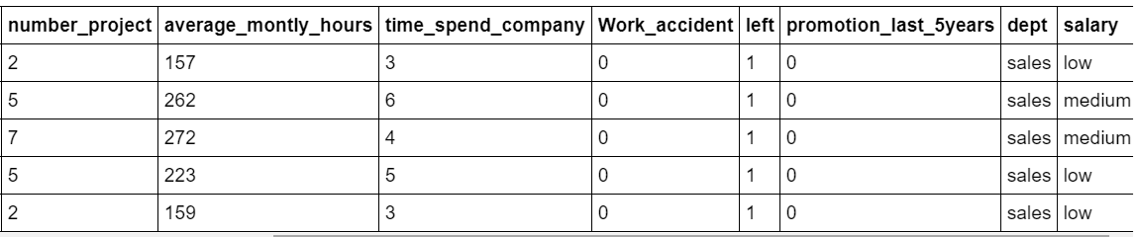
Variables
Explanatory (predictor or independent)
Response (outcome or dependent)
A variable can serve as independent in one study and dependent in another

Slide 5
Data Types of Variables - Quantitative versus Qualitative
Quantitative - Numerical data. Eg. weight, temperature, number_project
Qualitative - Non-numerical data. Eg. dept, salary

Slide 6
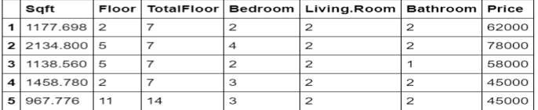
Types of Quantitative Variables
Continues - any numeric value. Eg. Sqft
Discrete - count of the presence of a characteristic, result, item, or activity. Eg. Floor

Slide 7
Qualitative Data: Categorical, Binary, and Ordinal
Categorical or Nominal. Eg - dept ( sales, RD etc. )
Binary. Eg. Left ( 1 or 0 )
Ordinal. Eg. salary ( low, medium, high )

Slide 8
Choosing Statistical Analysis based on data type

Slide 9
Types of Statistical Analysis
Descriptive Statistics - Describes data.
  Common Tools - Central tendency, Data distribution, skewness
Inferential Statistics - Draw conclusions from the sample & generalize for
entire population
  Common Tools - Hypothesis Testing, Confidence Intervals, Regression Analysis

Slide 10
Summarizing Data
Measure of Central Tendency
Measure of Variability
Visualizing Data

Slide 11
Measure of Central Tendency
Mean - Average of data, suited for continuous data with no outliers
Median - Middle value of ordered data, suited for continuous data with
outliers
Mode - Most occuring data, suited for categorical data ( both nominal and
ordinal )

Slide 12
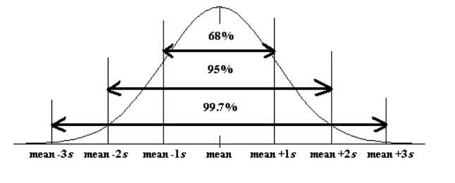
Measure of Variance
Range
Interquartile Range
Variance
Standard Deviation

Slide 13
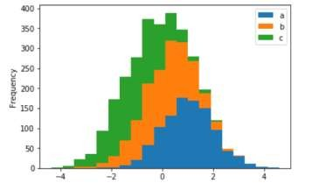
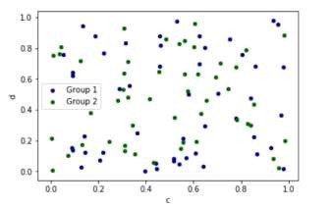
Visualizing Continuous Data
Histogram
ScatterPlot

Slide 14
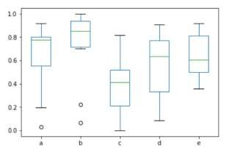
Visualizing Continuous Data - 2
Box-Plot

Slide 15
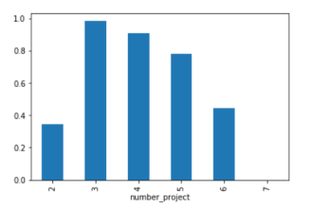
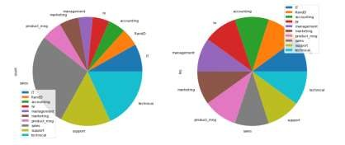
Visualizing Discrete Data
Histogram
Pie

Slide 16
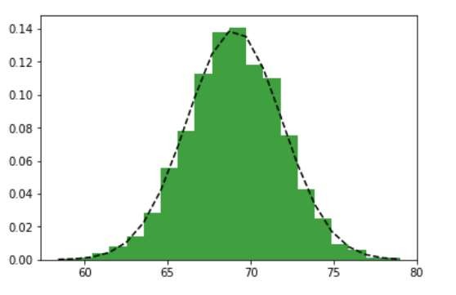
Normal Distribution
A probability function that describes how the values of a variable are distributed.
Symmetric distribution
Mean = 69, Std = 2.8
Notation Alert, mu & sigma term used for entire population
Height Distribution

Slide 17
Normal Distribution - 2
Empirical Rule of Normal Distribution : 68 - 95 - 99
Standard Normal Distribution : Mean = 0, Std = 1.0
Z-scores is a great way to understand where a specific observation fall wrt
entire population. It is basically number of std far from mean.

Slide 18
Introduction
Central Tendency
Data Distribution
Skewness
Correlation
Descriptive Statistics

Slide 19
Introduction
Hypothesis Testing
Confidence Intervals
Regression Analysis
Inferential Statistics

Slide 20
Chi-square Test of Independence
Correlation and Linear Regression
Analysis of Variance or ANOVA
Relationships between Variables

Slide 21
Thank You !!!

